Slide 1

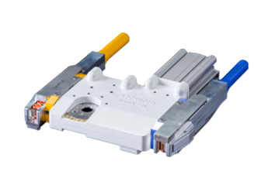

KIKK-EL Cap Changer
Pneumatic Automatic Cap Changer System

Slide 2
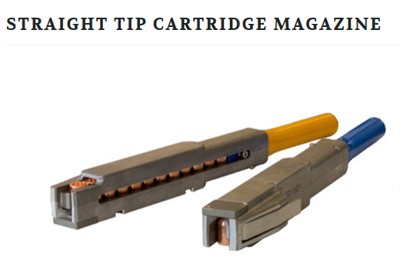
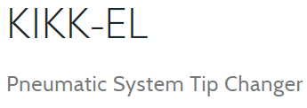


Light Compact
Easy to Install

Slide 3
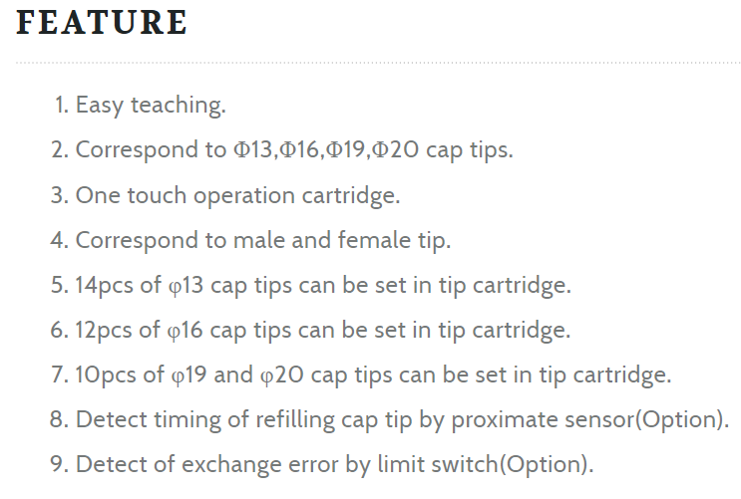
Features of our KIKK-EL Cap Changer

Slide 4
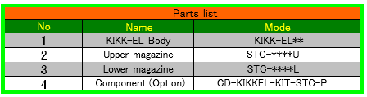
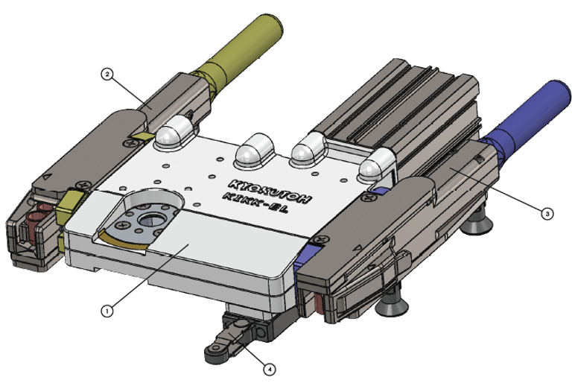
KIKK-EL

Slide 5
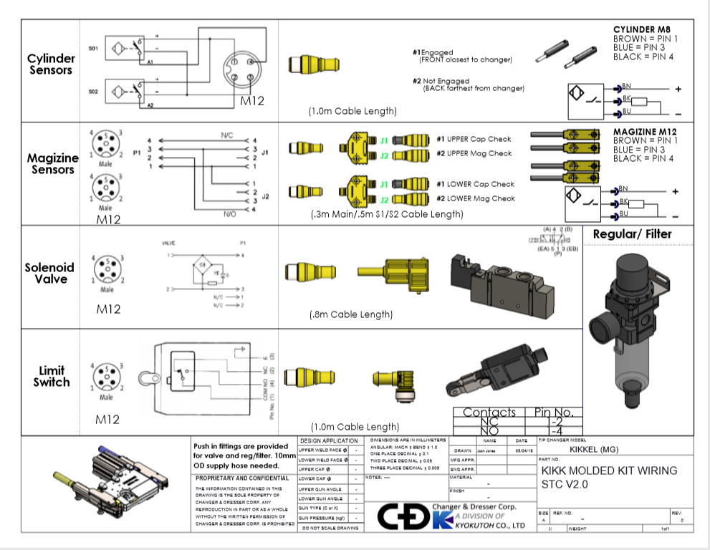
KIKK Molded Kit Mechanical switch

Slide 6
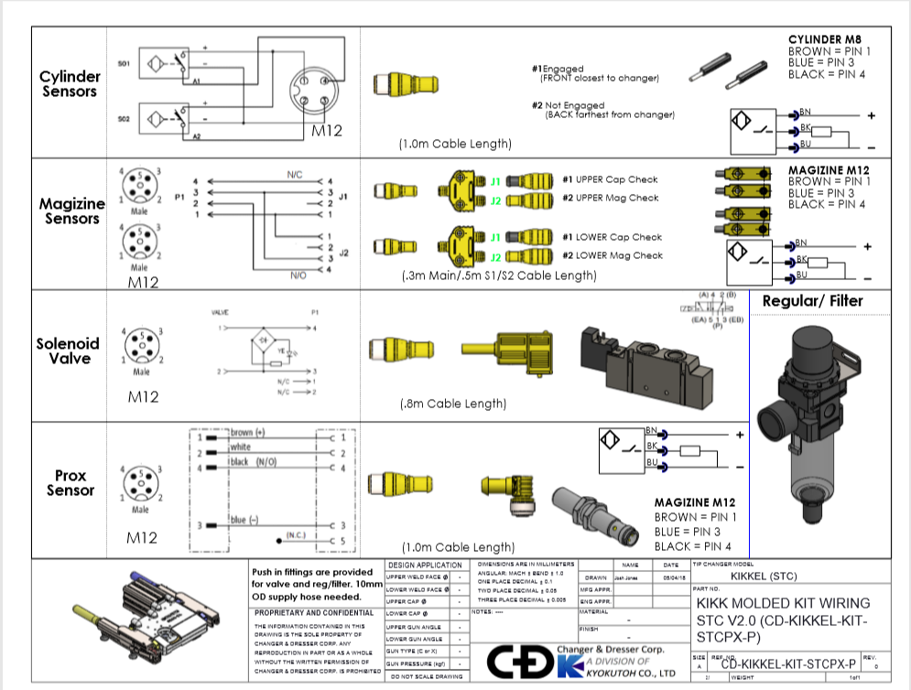
Molded Kit STC V2.0 Prox Switch.

Slide 7
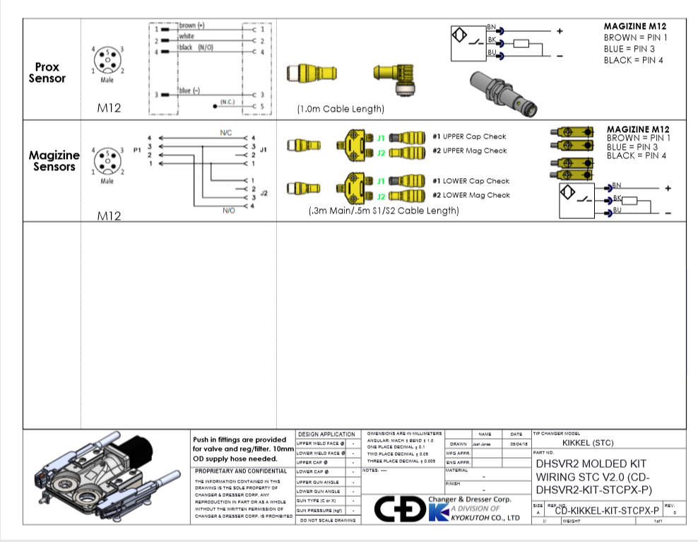
DHSVR2 Molded Kit

Slide 8
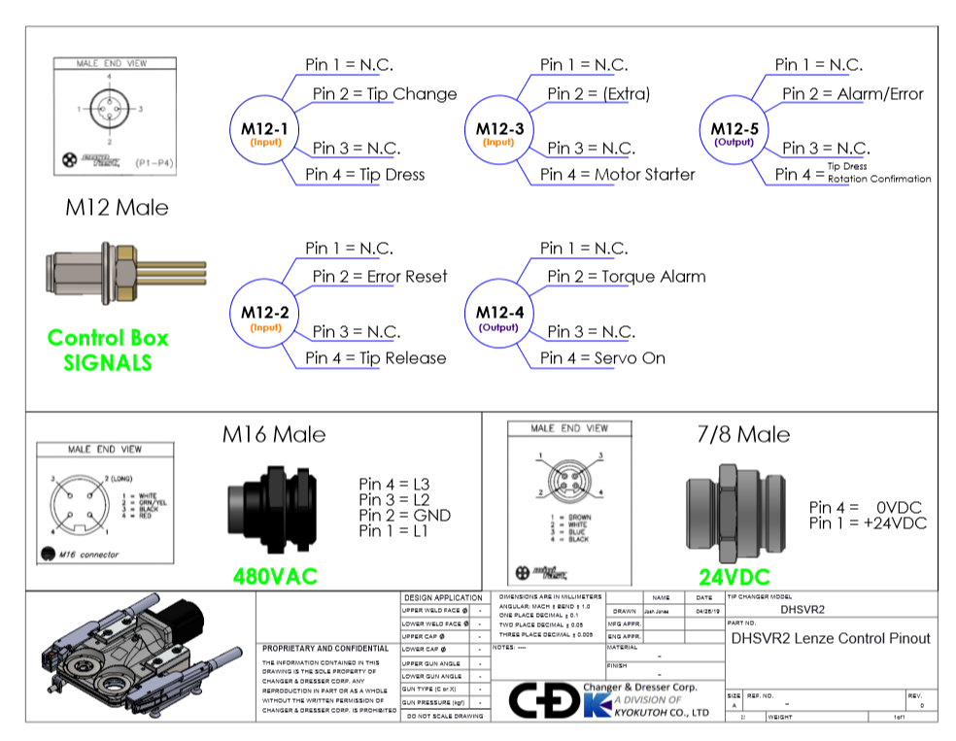
DHSVR2 LENZ Switch

Slide 9
 | Changer & Dresser KIKK Tip Changer.
QTY | PART # | DESCRIPTION | MANUF
1 | FA3-C3PA | 3/8" Filter/Regulator Combination Unit | Fabco Air
1 | MME-43WES-D024 | 3/8" NPT In/Out, 1/4" NPT exhaust, 5/2 valve w/ Cable Gland | Clippard
1 | 7000-40981-6560150 | Form BI (11 mm) – M12, male straight valve connector, black, weld spatter resistant | Murr
1 | FD 531-K50 | Mechanical limit switch, 1 N.O. contact + 1N.C., roller arm activation, 5-pin M12 connector | Pizzato
1 | WK 4.5T-1-RS 4.5T/S1587 | M12 90-Female 5-Pin to M12 STM 5-Pin Cordset (1m) | Murr
2 | Bi 6-EGT12FE-AP6X-H1141 | Inductive Prox, M12 Connector, PNP, DC, NO, 12mm x 6mm SN | TURCK
2 | RKC 4.4T-1-RSC 4.4T/S3060 | M12 STM/STF 4-Pin Cordset (1m) | TURCK
1 | 10 425 1038 | 10mm PIF x 3/8" NPT straight male fitting | Norgren
4 | 10 147 1038 | 10mm PIF x 3/8" ISO R 90 degree swivel male fitting | Norgren
1 | VB2-FSM4.4/2PKG3M-1/1 | T-Coupler, M12 4 x 2xM8 3 | TURCK
1 | VB2-FSM4.4/2FKM4 | T-Coupler, M12 4 x 2xM12 4 | TURCK
2 | MZCK 03P1011/KS35D | Magnetic cylinder sensors, M8 Connector, PNP (300mm) (Can't change,come w/cylinder) | Baumer
1 | FXEN-IOM88-0001-IP/CS30007 | 8 Input/8 IUTOYT-Ethernet AIM Station | TURCK

Slide 10
Customer list
Ford Motor Corporation
FCA
General Motors
Nissan
Tower
Magna

Slide 11
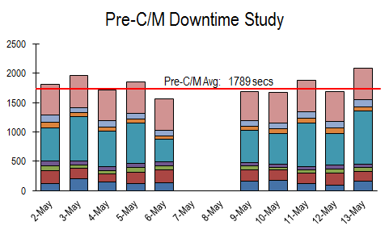
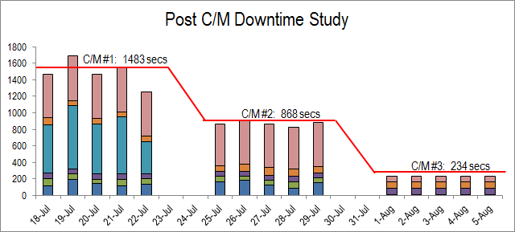
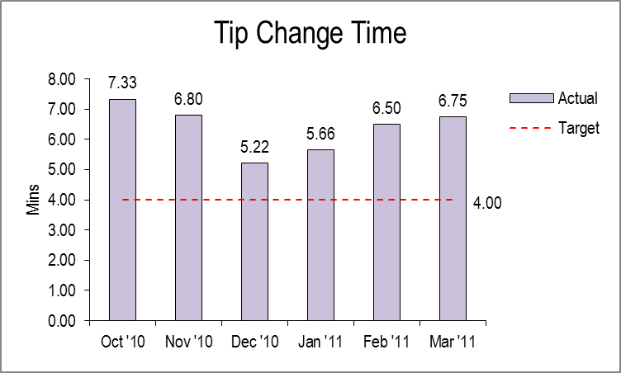
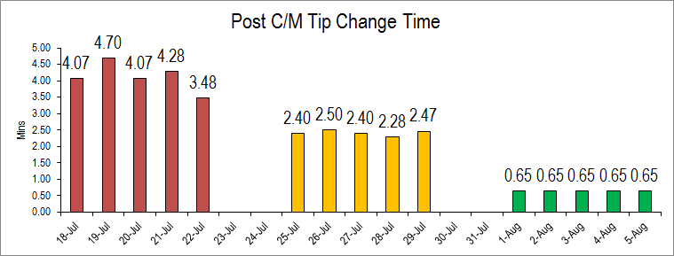
DATA COMPARISON STUDY:
Pre-C/M
Post-C/M

Slide 12
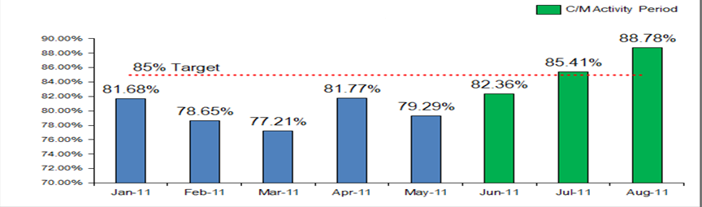
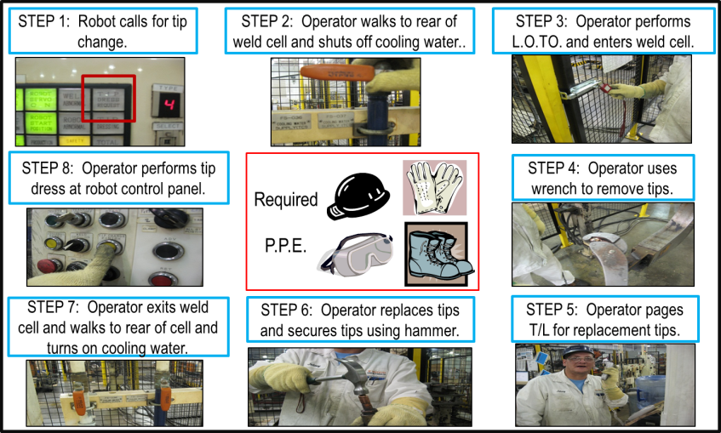
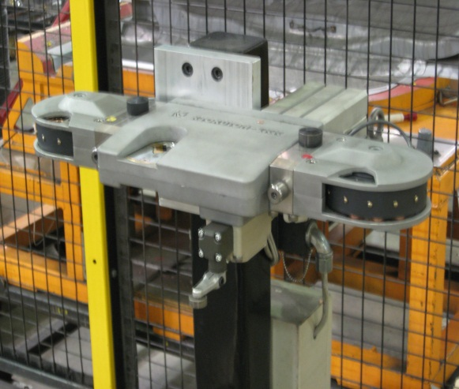
DATA COMPARISON STUDY:
Pre-C/M
Post-C/M
Auto change: Cycle takes 39 secs total.
8 Manual Steps

Slide 13
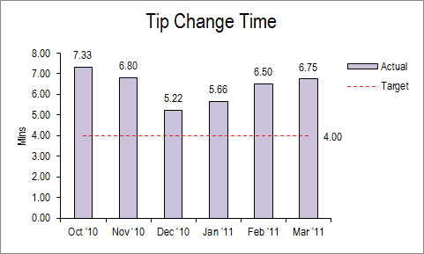
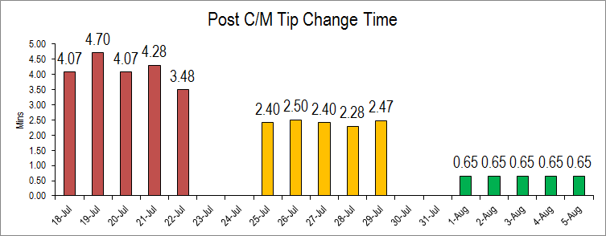
PLANNED GOAL VS. ACTUAL
GOAL 1
Reduce 145 seconds of tip change downtime to reach target of under 4 minutes.
Auto change completion in 39 secs/change (0.65 min/change).
ACTUAL 1
Eliminated 346 secs of tip change downtime by eliminating manual steps to achieve tip change time of 39 seconds.

Slide 14
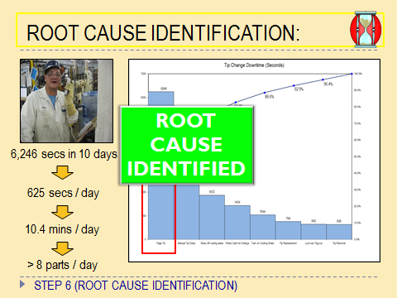
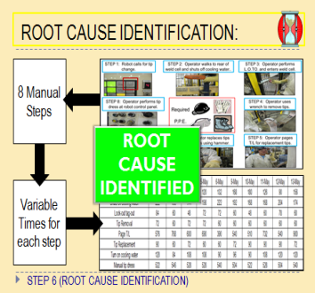
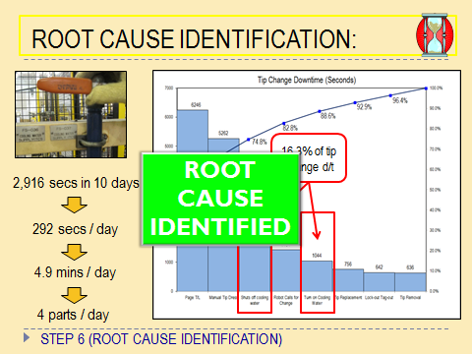
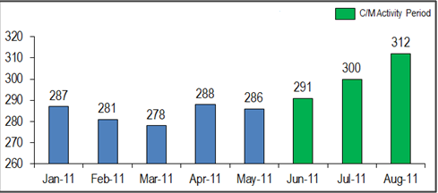
PLANNED GOAL VS. ACTUAL
GOAL 2
Produce 12 additional parts per day by counter measuring 3 root causes from Step 6.
ACTUAL 2
Starting with initial C/M activity, production has increased from 291 per shift to 312 per shift. This is a 42 part increase over a 2 shift operation.

Slide 15
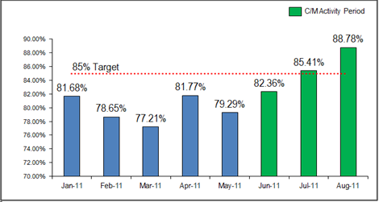
PLANNED GOAL VS. ACTUAL
GOAL 3
Accomplish Goal 1 and 2 to reach 85% O.E.E. as outlined by business plan.
ACTUAL 3
O.E.E. has increased to 89%. This is due to eliminating unplanned d/t for tip change and reducing planned tip change d/t by 86%.

